Slide 1
ME 203 Introduction to MATLAB
‹#›

Slide 2
Other Types of 2-D Plots
Polar Plots
Logarithmic Plots
Bar Graphs
Pie Charts
Histograms
X-Y graphs with 2 y axes
Function Plots

Slide 3
Polar Plots
Some functions are easier to specify using polar coordinates than by using rectangular coordinates
For example the equation of a circle is
y=sin(x)
in polar coordinates

Slide 4
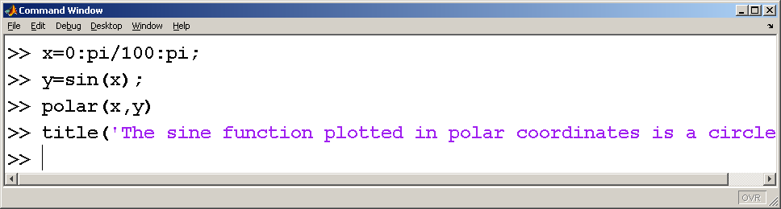
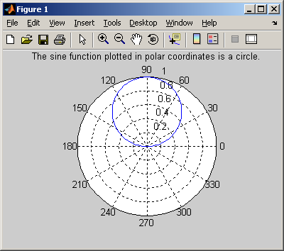

Slide 5
Logarithmic Plots
A logarithmic scale (base 10) is convenient when
a variable ranges over many orders of magnitude, because the wide range of values can be graphed, without compressing the smaller values.
data varies exponentially.
plot – uses a linear scale on both axes
semilogy – uses a log₁₀ scale on the y axis
semilogx – uses a log₁₀ scale on the x axis
loglog – use a log₁₀ scale on both axes

Slide 6
Example: Logarithmic Plots
Given y = 5x², where 0 ≤ x ≤ 50. Create plots with
(a) linear scale on both axes
(b) log₁₀ scale on horizontal axis
(c) log₁₀ scale on vertical axis
(d) log₁₀ scale on both the axes
Create all plots in the same figure window

Slide 7
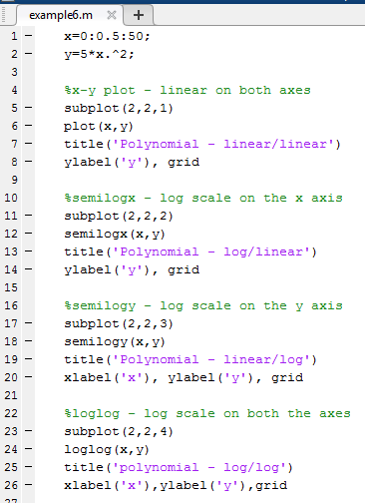
Logarithmic Plots (Matlab Code)

Slide 8
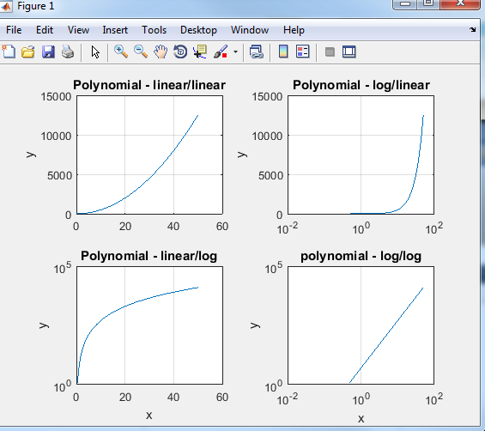
Logarithmic Plots (from previous slide)

Slide 9
Bar Graphs, Stem Charts, Stair Charts, and Pie Charts
MATLAB includes a whole family of graphs and charts
bar(x) – vertical bar graph
barh(x) – horizontal bar graph
bar3(x) – 3-D vertical bar graph
bar3h(x) – 3-D horizontal bar graph
pie(x) – pie chart
pie3(x) – 3-D pie chart
stem(x)-stem chart
stairs(x)-stair chart
Use the help function for how to use these

Slide 10
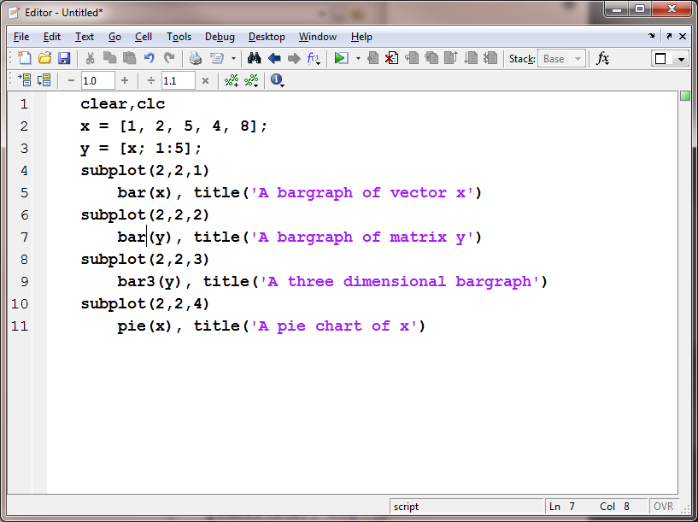

Slide 11
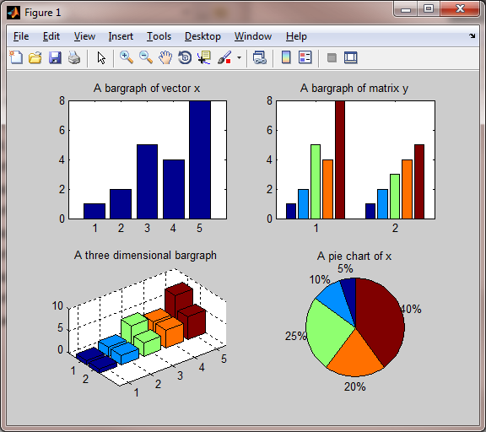

Slide 12
Histograms
A histogram is a plot showing the distribution of a set of values
histogram(X,M) - plots a histogram of X, using M bins
X is a vector and M is a scalar

Slide 13
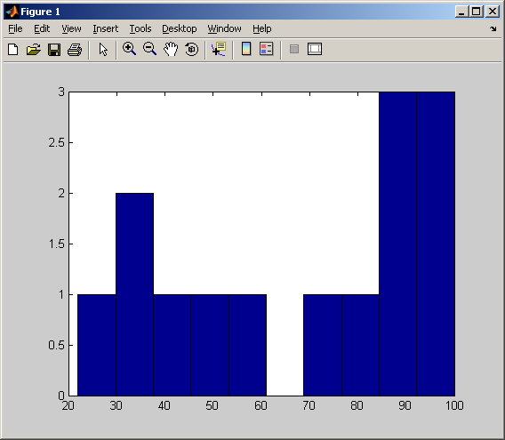
x = [100,95,74,87,22,78,34,35,93,88,86,42,55,48];
histogram(x, 10)

Slide 14
X-Y Graphs with Two Y Axes
Sometimes it is useful to overlay two x-y plots onto the same figure. However, if the order of magnitude of the y values are quite different, it may be difficult to see how the data behave.

Slide 15
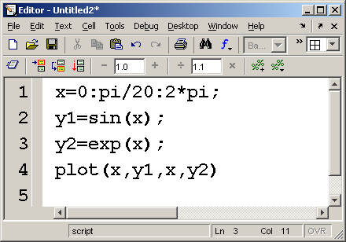
For example

Slide 16
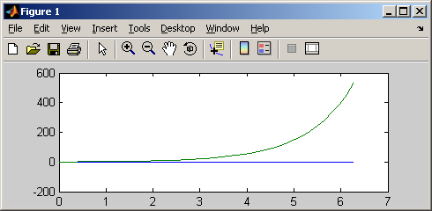
Scaling Depends on the largest value plotted
Its difficult to see how the blue line behaves, because the scale isn’t appropriate

Slide 17
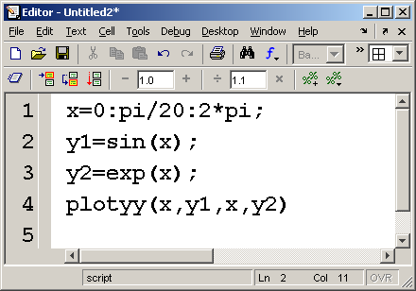
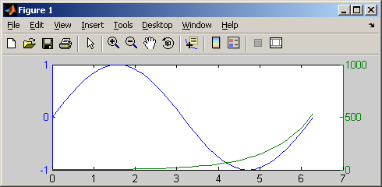
The plotyy function allows you to use two scales on a single graph

Slide 18
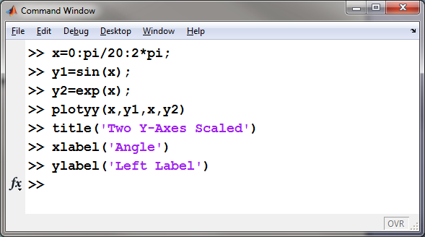
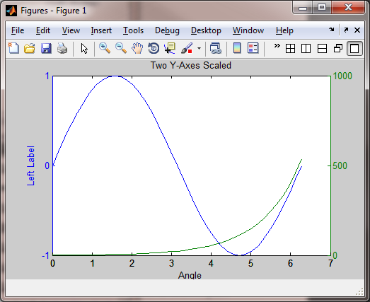
Adding Labels
But how do you add the right axis label?

Slide 19
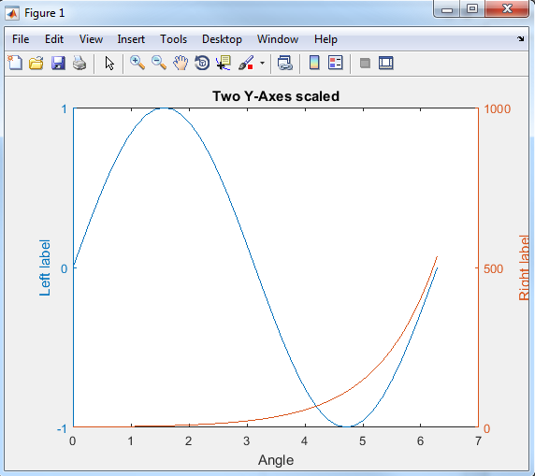
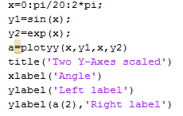
Give the plot a name – also called a ‘handle’

Slide 20
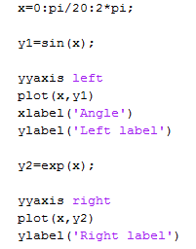
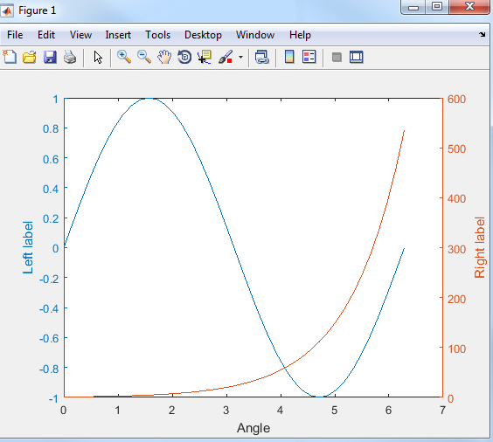
X-Y Graphs with Two Y Axes - Alternate method
Using yyaxis (MATLAB 9.0)
Ref: https://www.mathworks.com/help/matlab/ref/yyaxis.html

Slide 21
Function Plots
Function plots allow you to use a function as input to a plot command, instead of a set of ordered pairs of x-y values
fplot(@(x) sin(x) , [-2*pi,2*pi])
independent variable
function
range of the independent variable – in this case x

Slide 22
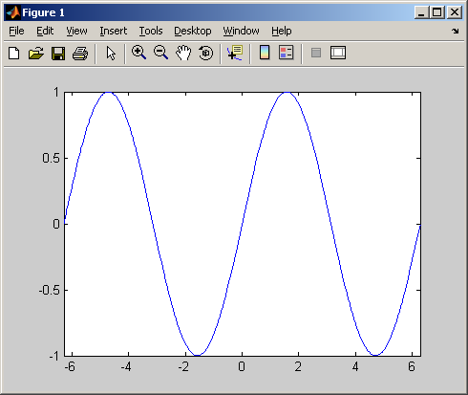

Slide 23
Three Dimensional Plotting
Line plots – plot3(x,y,z)
Velocity plots – quiver(x,y,u,v)
Surface plots – surf(x,y,z)
Contour plots – contour(x,y,z)

Slide 24
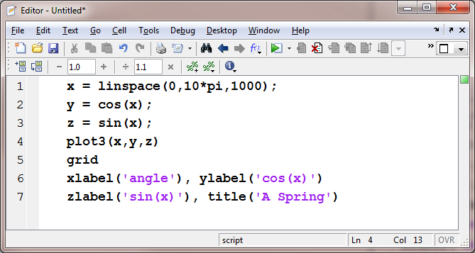
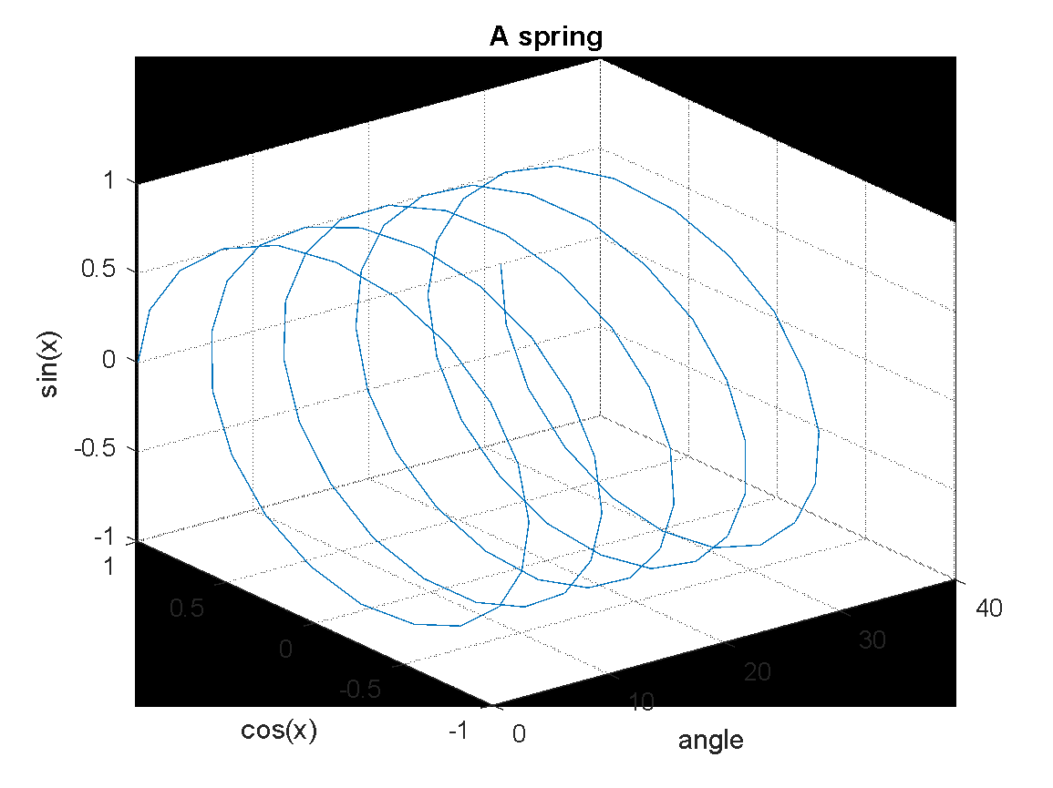
Three Dimensional Line Plots
These plots require a set of order triples ( x-y-z values) as input
The z-axis is labeled the same way the x and y axes are labeled

Slide 25
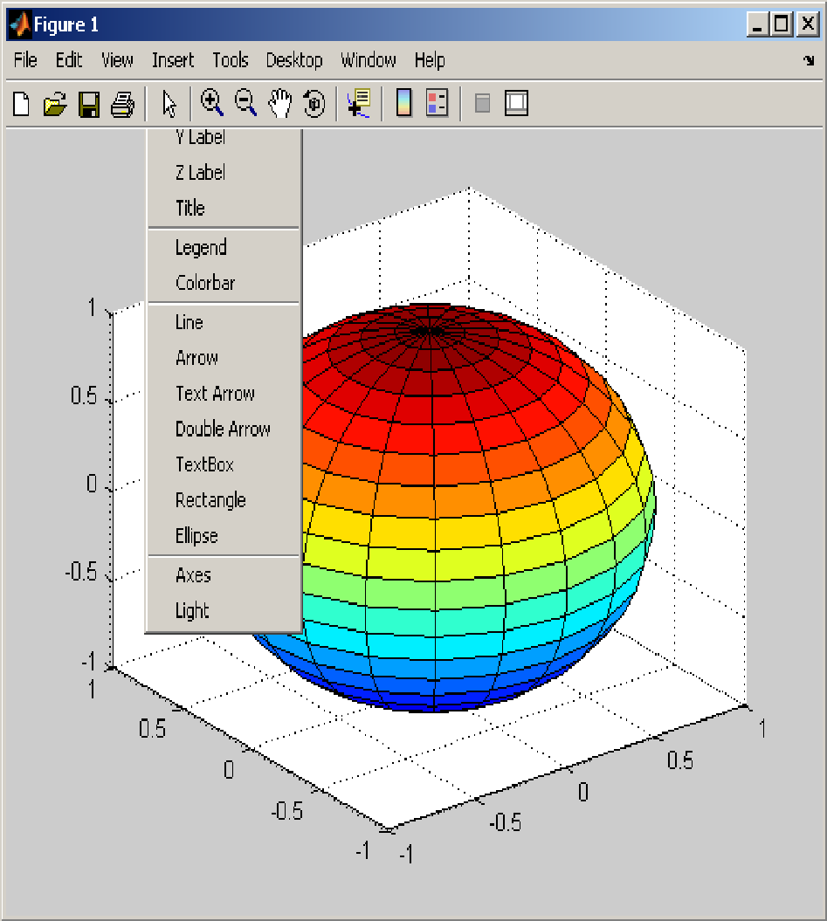
Once you’ve created a plot you can adjust it using the menu bar
In this picture the insert menu has been selected
Notice you can use it to add labels, legends, a title and other annotations
If you adjust a figure interactively, you’ll lose your improvements when you rerun your program

Slide 26
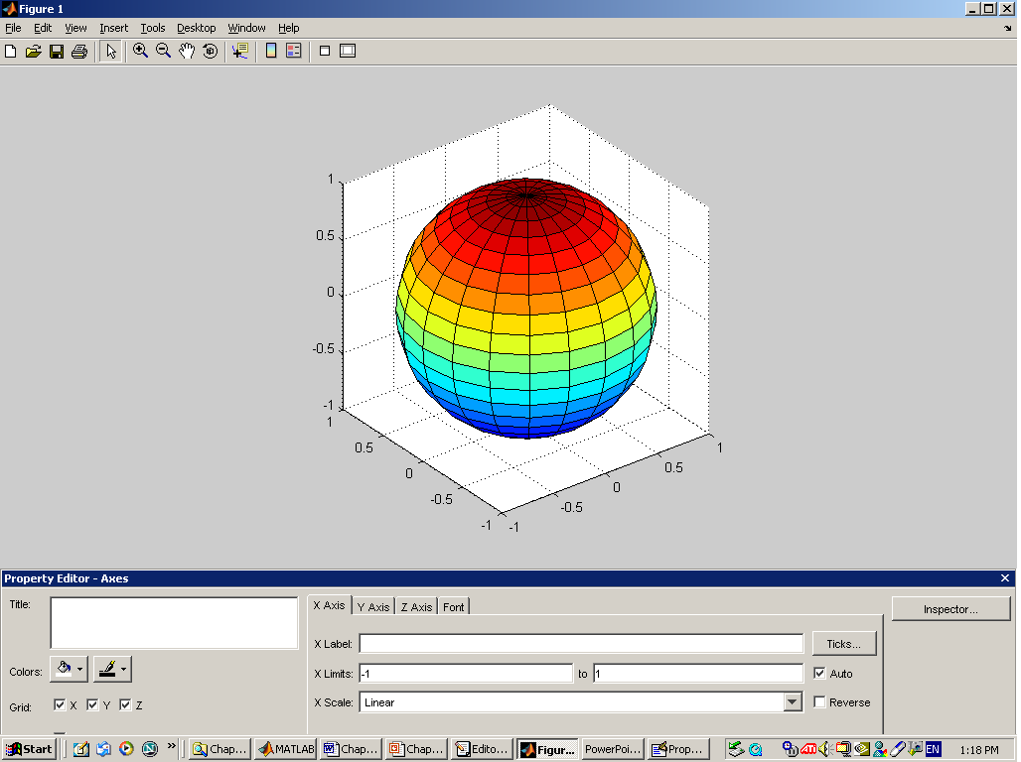
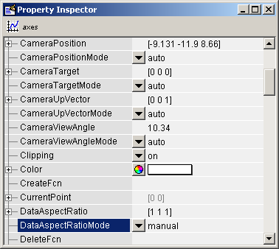
Select
Edit-> Axis Properties from the menu tool bar
Explore the property editor to see some of the other ways you can adjust your plot interactively
Change the Aspect Ratio
Select Inspector from the Property Editor

Slide 27
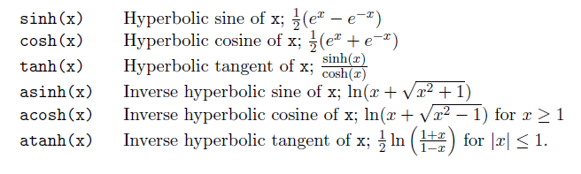
Hyperbolic Functions
The hyperbolic functions are functions of the natural exponential function e^{x}

Slide 28
Hyperbolic Functions Example:
The following equation gives the heat transfer for an adiabatic fin: q=M tanh (mL)
Given: M = 8.3, m=14.2
Calculate :
a) q for L=0.19
b) plot q for L=0:0.01:.2 (use blue stars and a blue line)

Slide 29
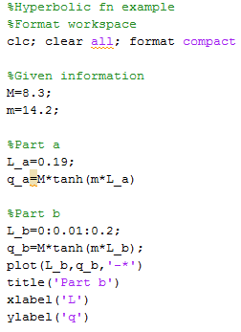
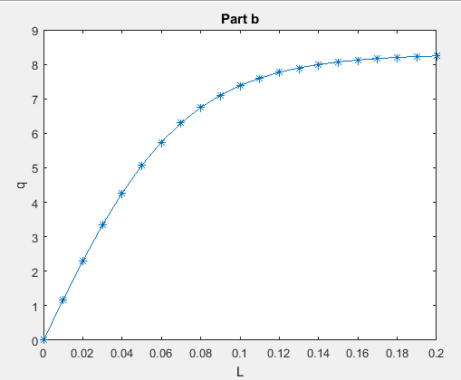
Hyperbolic Functions Example:
Results
q_a =
8.2251

Slide 30
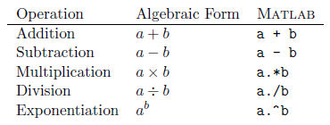
Element-by-Element Array-Array Mathematics
When two arrays have the same dimensions, addition, subtraction, multiplication, and division apply on an element-by-element basis
Use a period before all operations except addition and subtraction

Slide 31
Element-by-Element Array-Array Mathematics Examples:
>> A = [2 5 6]; B = [2 3 5];
>> C = A.*B
C =
4 15 30
>> D = A./B
D =
1.0000 1.6667 1.2000
>> E = A.^B
E =
4 125 7776
Notes:
y = [0, 0.33, 4.13, 6.29, 6.85, ...
11.19, 13.19, 13.96, 16.33, ...
18.77];

